Slide 2
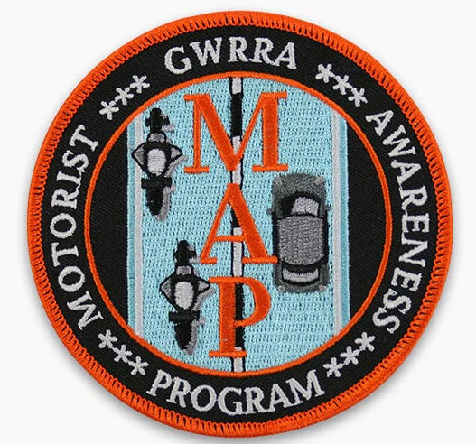
Motorist Awareness
Mini Make-A-Point
©

Slide 3
Ready For A Quiz?
Put your smart phones away!

Slide 4
Who is the Artist?
This cat’s name is Sam

Slide 5
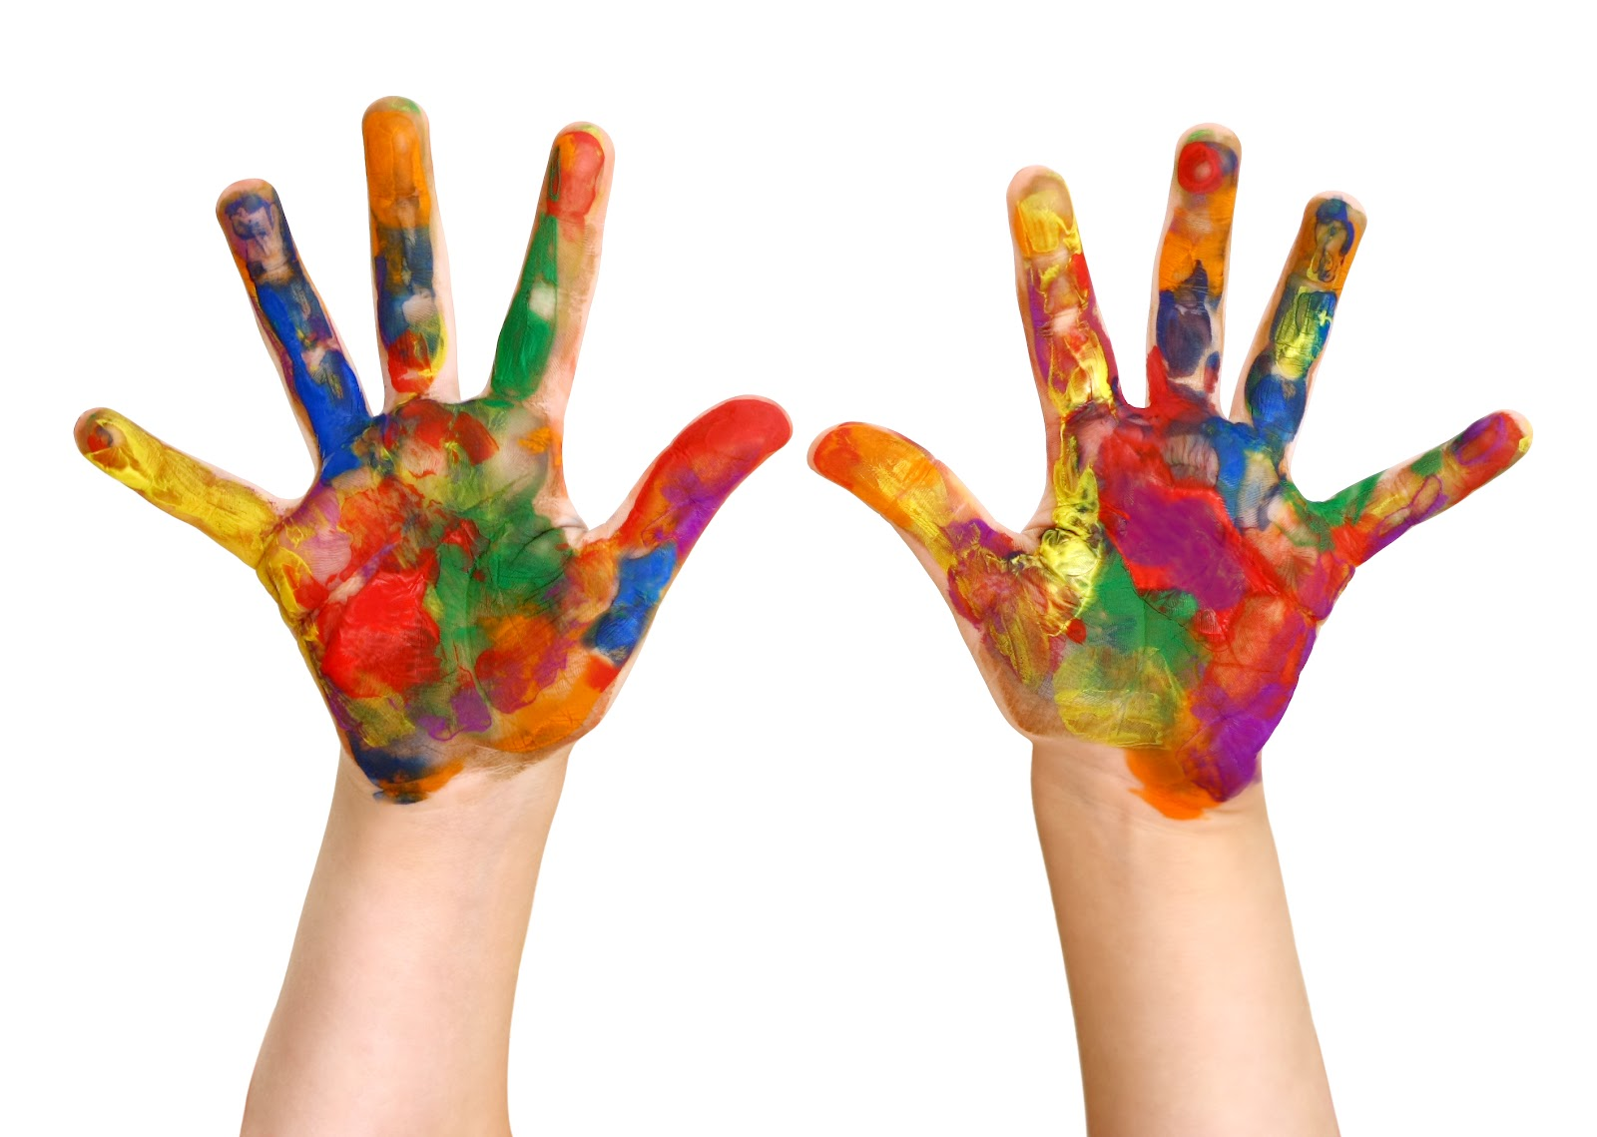
Is it my next door neighbor’s daughter?
Notes:
n

Slide 6
An art student?

Slide 7
Or a famous artist?

Slide 8
Andy Warhol
This painting is from a series called, “25 Cats Named Sam.”

Slide 9
Lets do another one!

Slide 10
Who DID NOT Graduate From College?
Pick 1

Slide 11
Brian May
Played Guitar For Queen

Slide 12
Shaqille O’Neal
Professional Basketball Player

Slide 13
Peter Jennings
News Anchor – ABC News Tonight

Slide 14
Rebel Wilson
Actress – Pitch Perfect and Bridesmaids

Slide 15
John Glenn
Astronaut and Senator

Slide 16
Peter Jennnings – Anchor ABC News
John Glenn – Astronaut and Senator
Peter Jennings does not have a college degree.
John Glenn received a degree 20 years after his first space flight!

Slide 17
Brian May – PhD in Astrophysics
Shaquille O’Neal – PhD in Education
Rebel Wilson – Degrees in Mathematics and Law
All of the above have advanced degrees

Slide 18
What does this have to do with Motorist Awareness?

Slide 19
Motorist Awareness
Bias and Stereotypes

Slide 20
Stereotyping is not limited to those who are biased.
We use stereotypes all the time.
They are a kind of mental shortcut.
Research shows that we ALL use categories to make sense of the world around us.
Our ability to categorize and evaluate is an important part of human intelligence.

Slide 21
Stereotypes May Have Emerged from Group Dynamics

Slide 22
Connections made often enough in the conscious mind eventually become unconscious stereotypes or bias.
These connections come from mass media, peer pressure, and other cultural sources.
Many children have entrenched and definite stereotypes by the age of five.
People can teach themselves to weaken negative stereotypes by pausing to examine conscious facts.
This is called, “de-automization”

Slide 23
When Motorists “Think Motorcycles”
Do they think this?
Or this?

Slide 24
This?
Or This?

Slide 25
This
Or This

Slide 26
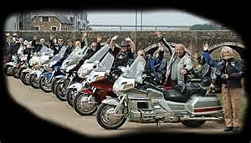
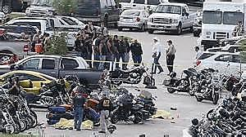
This?
Or This?

Slide 27
The media doesn’t really help.

Slide 28
How Do We Fix This?

Slide 29
Remember–In 2013:
There were 4668 motorcycle fatalities and
8800 injuries
Riders were 26 times more likely to die in a crash and
5 times more likely to be injured

Slide 30
We can help drivers question their negative stereotypes and SEE the responsible rider…
Queen Latifah

Slide 31
by constantly giving them positive images.

Slide 32
And by riding as often as you can!

Slide 33
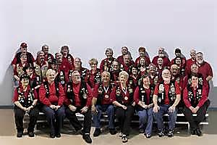
If you can’t ride, wear your vest! Wear it to the grocery store or the mall!

Slide 34
Because we have Mad Ninja Skillz…and we are Great Ambassadors for our sport!

Slide 35
Summary

Slide 36
We had a fun quiz.
We learned a big word. What was it?
We saw examples of stereotypes. Can you name some of them?
We learned that we can help motorists question their negative stereotypes.
We have a few suggestions for “accentuating the positive.” What is one of them?

Slide 37
Thanks!!!!!!

